Slide 1
Nucleic Acids

Slide 2
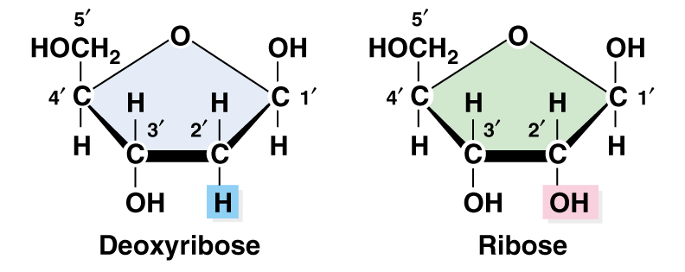
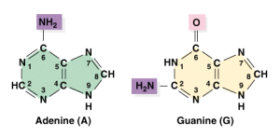
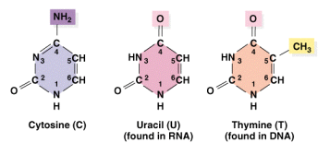

Nucleotide = monomers that make up DNA and RNA
Three components
1. Pentose (5-carbon) sugar
DNA = deoxyribose
RNA = ribose
(compare 2’ carbons)
2. Nitrogenous base
Purines
Adenine
Guanine
Pyrimidines
Cytosine
Thymine (DNA)
Uracil (RNA)
3. Phosphate group attached to 5’ carbon

Slide 3
Nucleotides are linked by phosphodiester bonds to form polynucleotides.
Phosphodiester bond
Covalent bond between the phosphate group (attached to 5’ carbon) of one nucleotide and the 3’ carbon of the sugar of another nucleotide.
5’ and 3’
The ends of the DNA or RNA chain are not the same. One end of the chain has a 5’ carbon and the other end has a 3’ carbon.

Slide 4
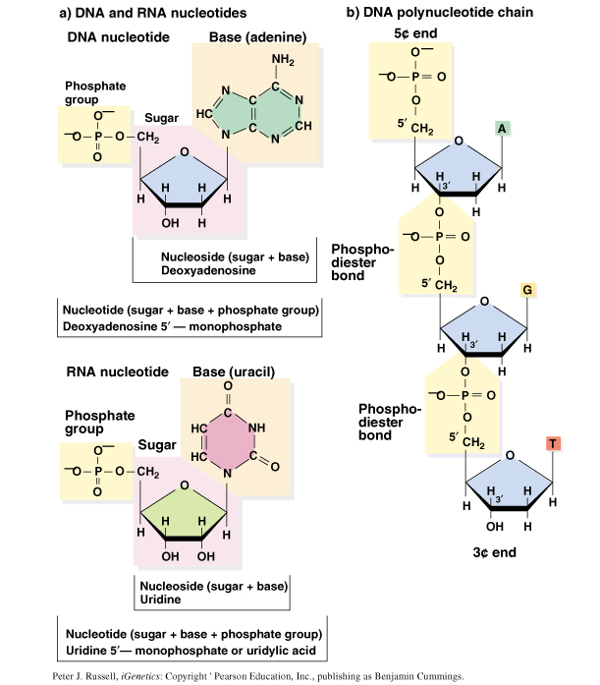
5’ end
3’ end

Slide 5
How it was known that DNA (or RNA) is the Genetic material?

Slide 6
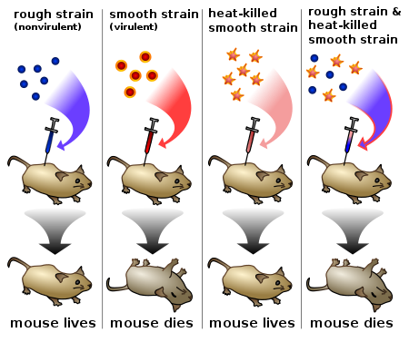
Frederick Griffith in 1928: Bacterial Transformation

Slide 7
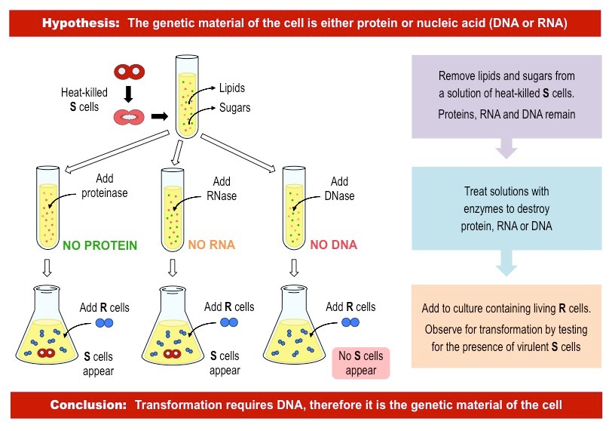
Avery-MacLeod-McCarty Experiment – DNA as the Genetic Material of the Cell (1944)

Slide 8
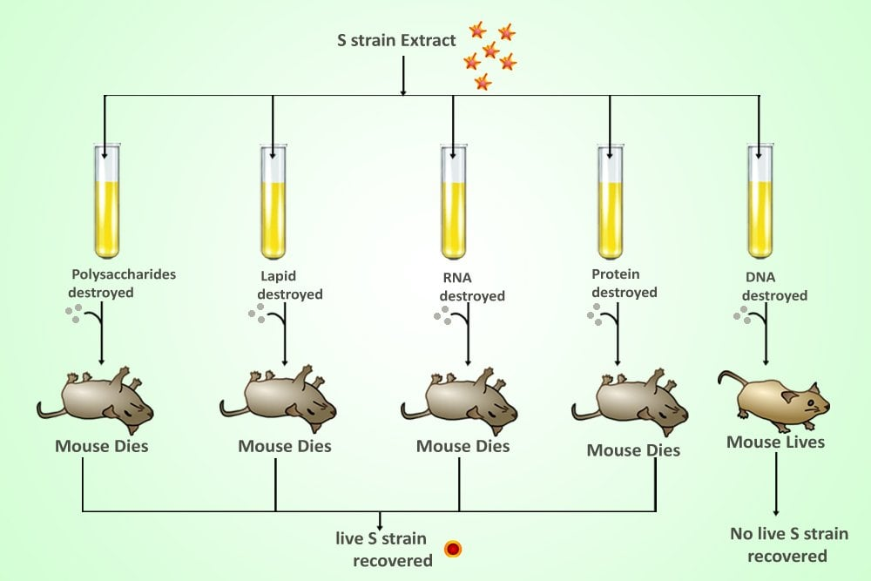

Slide 9
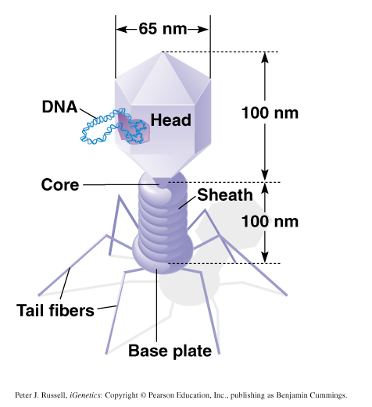
Bacteriophage = Virus that attacks bacteria and replicates by invading a living cell and using the cell’s molecular machinery.
Structure of T2 phage
Bacteriophages
are composed of
DNA & protein
Hershey-Chase Bacteriophage Experiment - 1953

Slide 10
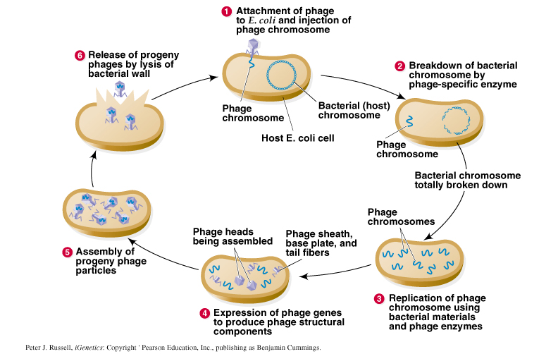
Life cycle of virulent T2 phage:

Slide 11
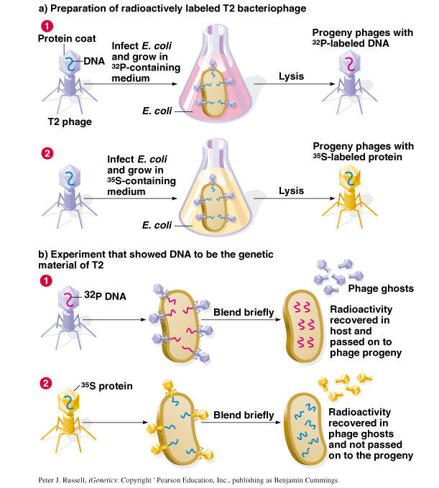
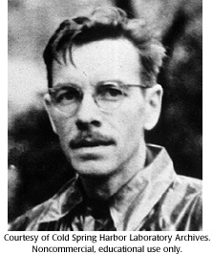
T2 bacteriophage is composed of DNA and proteins:
Set-up two replicates:
  Label DNA with ³²P
  Label Protein with ³⁵S
3. Infected E. coli bacteria with two types of labeled T2
4. ³²P is discovered within the bacteria and progeny phages, whereas ³⁵S is not found within the bacteria but released with phage ghosts.
Hershey-Chase Bacteriophage Experiment - 1953
Alfred Hershey

Slide 12
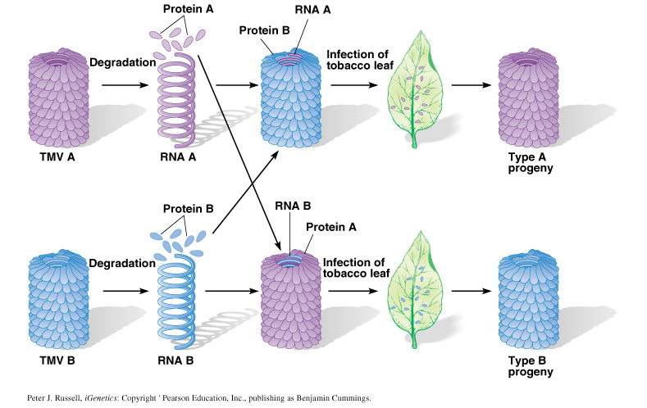
Gierer & Schramm Tobacco Mosaic Virus (TMV) Experiment - 1956
Fraenkel-Conrat & Singer - 1957
Demonstrated that RNA is the genetic material of TMV.
Notes:
Numerous viruses uses RNA as the genetic material. But no known prokaryotes or eukaryotes have RNA as their genetic material.

Slide 13
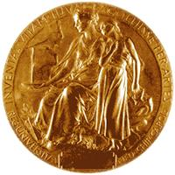
Conclusions about these early experiments:
Hershey-Chase 1953:
DNA (not protein) is the genetic material.
Gierer & Schramm 1956/Fraenkel-Conrat & Singer 1957:
RNA (not protein) is genetic material of some viruses, but no known prokaryotes or eukaryotes use RNA as their genetic material.
Alfred Hershey
Nobel Prize in Physiology or Medicine
1969

Slide 14
How DNA stores information?
How DNA gets duplicated before cell division?
How the information flows within the cells?
Is it that all answers are there in the DNA structure?

Slide 15
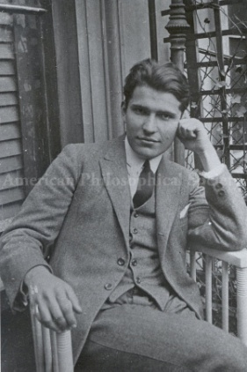
Structure of DNA
James D. Watson/Francis H. Crick 1953 proposed the Double Helix Model based on two sources of information:
Base composition studies of Erwin Chargaff
  indicated double-stranded DNA consists of ~50% purines (A,G) and ~50% pyrimidines (T, C)
  amount of A = amount of T and amount of G = amount of C
  (Chargraff’s rules)
  %GC content varies from organism to organism
Examples: %A %T %G %C %GC
Homo sapiens 31.0 31.5 19.1 18.4 37.5
Zea mays 25.6 25.3 24.5 24.6 49.1
Drosophila 27.3 27.6 22.5 22.5 45.0
Aythya americana 25.8 25.8 24.2 24.2 48.4

Slide 16
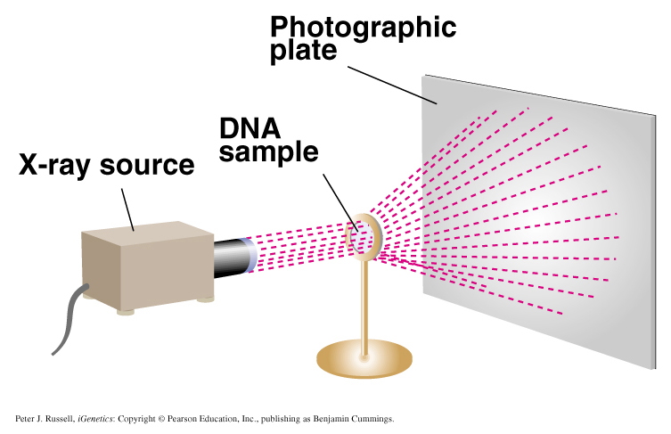
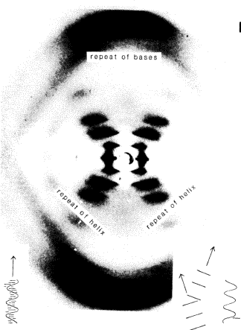
Structure of DNA
James D. Watson/Francis H. Crick 1953 proposed the Double Helix Model based on two sources of information:
X-ray diffraction studies by Rosalind Franklin & Maurice Wilkins
Conclusion-DNA is a helical structure with
distinctive regularities, 0.34 nm & 3.4 nm.

Slide 17
Double Helix Model of DNA: Six main features
Two polynucleotide chains wound in a right-handed (clockwise) double-helix.
Nucleotide chains are anti-parallel: 5’ → 3’
3’ ← 5’
Sugar-phosphate backbones are on the outside of the double helix, and the bases are oriented towards the central axis.
Complementary base pairs from opposite strands are bound together by weak hydrogen bonds.
A pairs with T (2 H-bonds), and G pairs with C (3 H-bonds).
5’-TATTCCGA-3’
3’-ATAAGGCT-5’
Base pairs are 0.34 nm apart. One complete turn of the helix requires 3.4 nm (10 bases/turn).
Sugar-phosphate backbones are not equally-spaced, resulting in major and minor grooves.

Slide 18
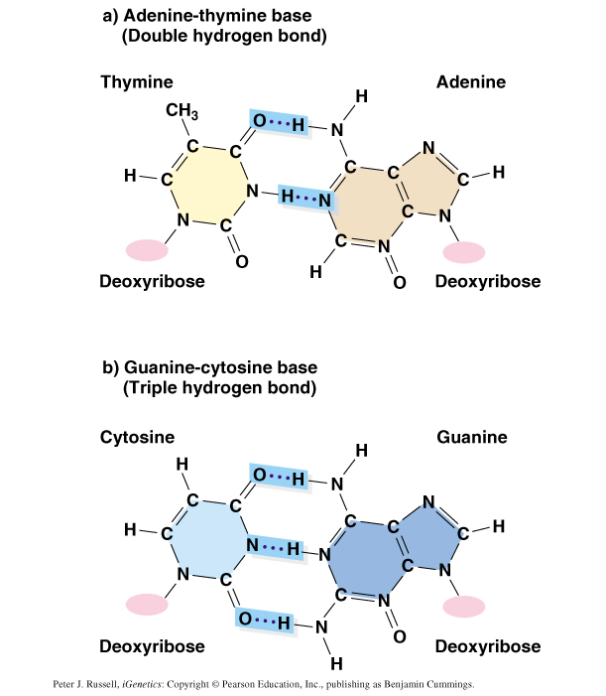

Slide 19
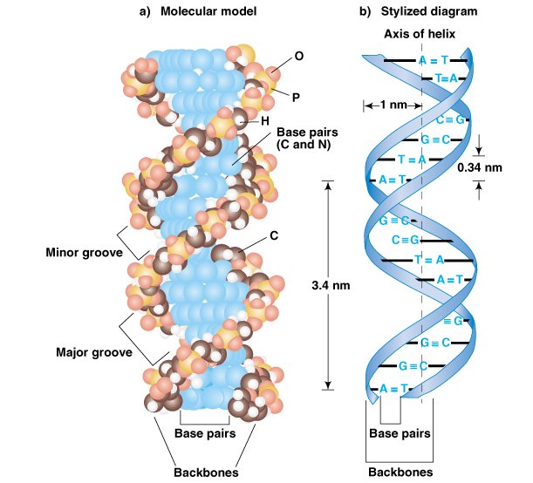
Fig. 2.12
Type B-DNA
Other DNA forms include:
A-DNA:
Right-handed double helix with 11 bases per turn; shorter and wider at 2.2 nm diameter. Exists in some DNA-protein complexes.
Z-DNA:
Left-handed double helix with 12 bases per turn; longer and thinner at 1.8 nm diameter.

Slide 20
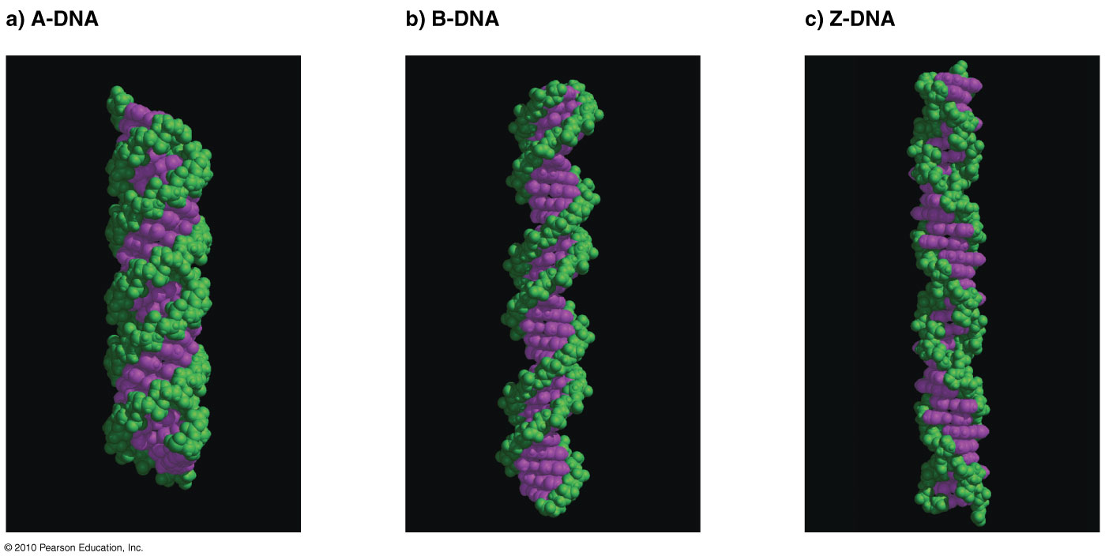
Type A, B, and Z conformations of DNA
Fig. 2.14

Slide 21
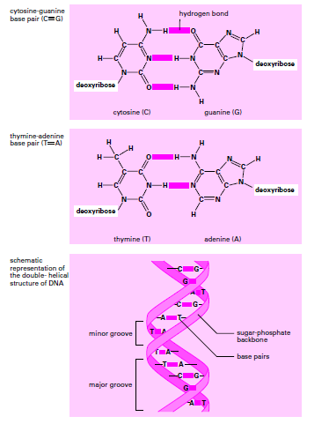
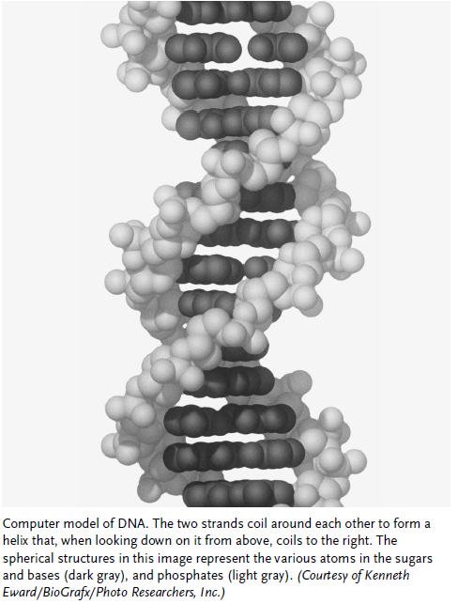

Slide 22
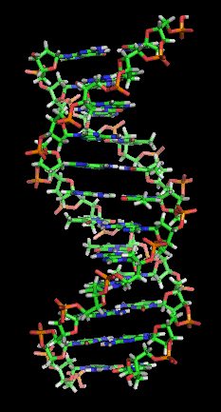
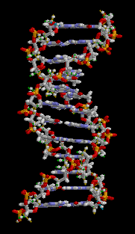
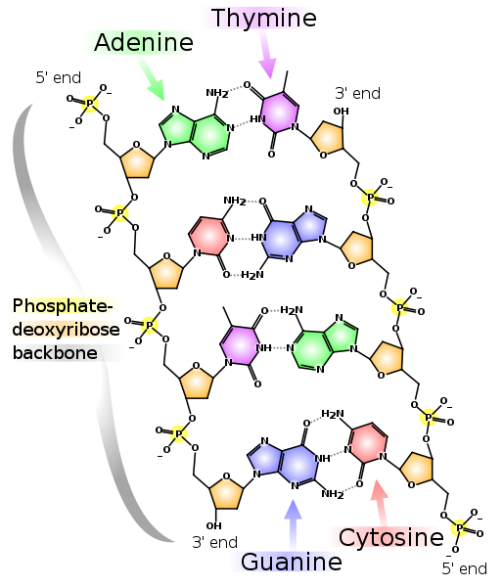

Slide 23
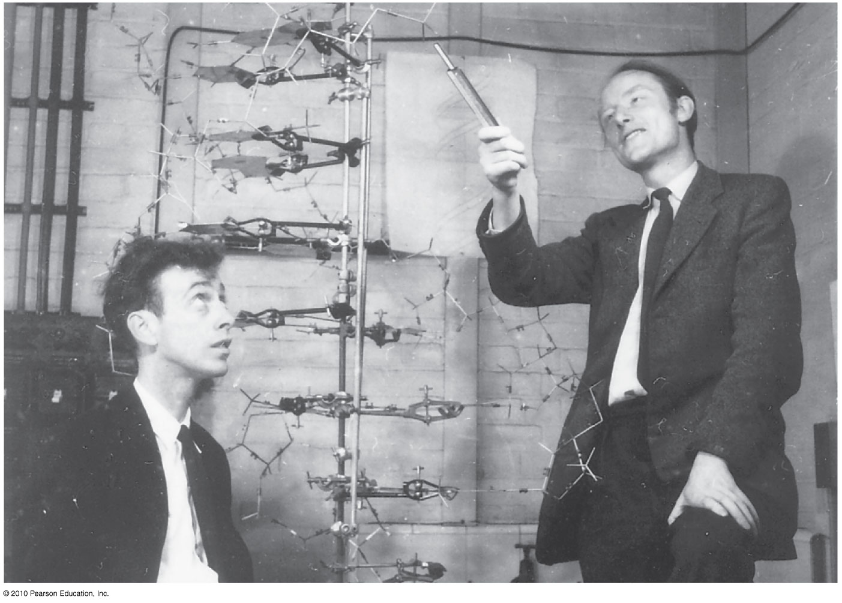

Slide 24
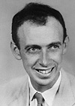
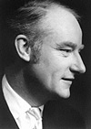
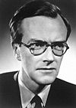
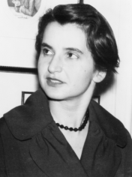
1962: Nobel Prize in Physiology and Medicine
James D.
Watson
Francis H.
Crick
Maurice H. F.
Wilkins
What about?
Rosalind Franklin

Slide 25
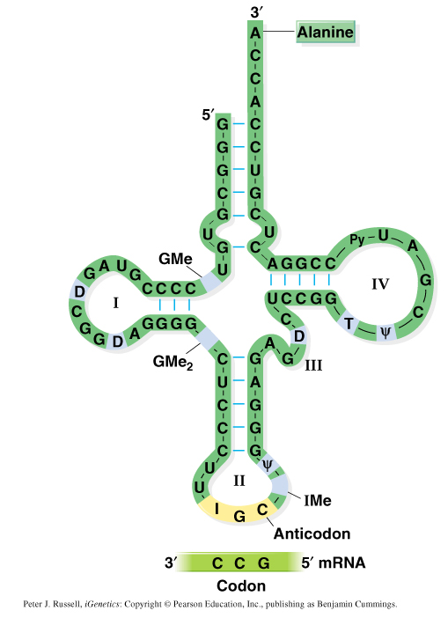
RNA possesses uracil (U) not thymine (T)
A pairs with U and C pairs with G
Examples:
mRNA messenger RNA
tRNA transfer RNA
rRNA ribosomal RNA
snRNA small nuclear RNA
miRNA micro RNA
siRNA small interfering RNA
RNA secondary structure:
single-stranded
Function in transcription
(RNA processing) and translation
Yeast Alanine tRNA

